Slide 1
21MAT212 MATHEMATICS FOR INTELLIGENT SYSTEMS-4
PROJECT PRESENTATION
TEAM-06

Slide 2
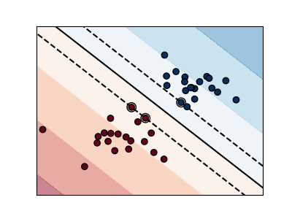
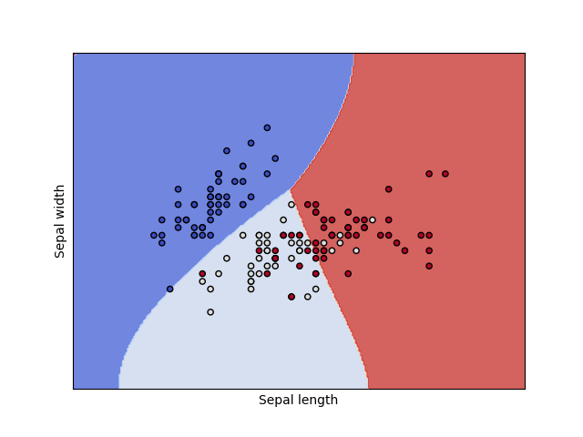
SOFT MARGIN SVM FORMULATION
Prof. Sowmya. V,
- CEN
Prof. K. P. Soman,
Head - CEN

Slide 3
Rachure charith sai cb.en.u4aie20055
Menta sai akshay cb.en.u4aie20040
TEAM-6
Sajja bala karthikeya cb.en.u4aie20065
Penaka vishnu reddy cb.en.u4aie20048

Slide 4
Defining SVM
01
Soft Margin svm
02
Table of contents
implementation
03
04
Conclusion
Comparing Hard Margin and Soft Margin SVM
Primal And Dual Formulation
Implementing Soft Margin SVM on real world dataset

Slide 5
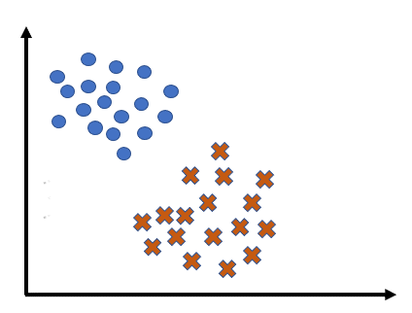
Defining SVM
SVM constructs a hyperplane that separates two classes (can be extended for multiclass).
A good separation is achieved by the hyperplane that has the largest distance to the nearest training-data point of any class (so-called functional margin/maximum margin), since in general the larger the margin, the lower the generalization error of the classifier.

Slide 6
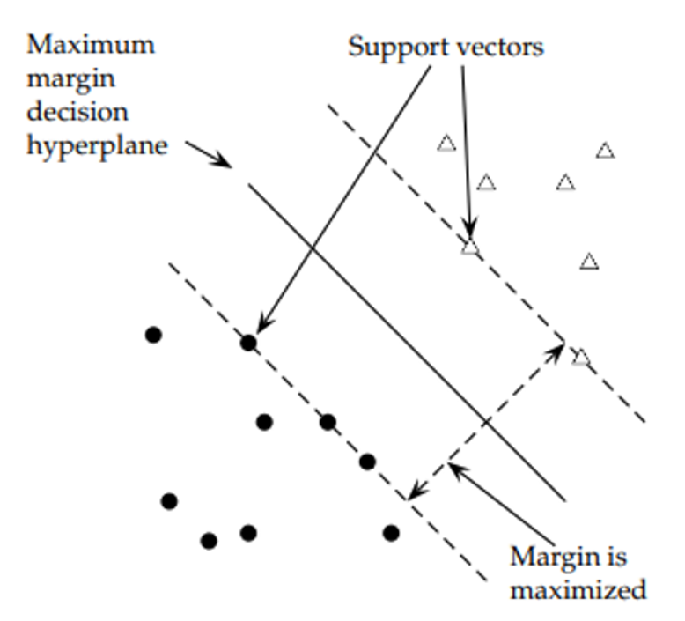
The two planes parallel to the classifier and which pass through one or more points in the data set are called bounding planes.
The distance between these bounding planes is called the margin and SVM learning means finding a central hyperplane that maximizes this margin.
The points falling on the bounding planes are called support vectors.

Slide 7
Linear SVM vs Non-Linear SVM
Linear SVM
It can be easily separated with a linear line.
Data is classified with the help of a hyperplane.
Data can be easily classified by drawing a straight line.
Non-Linear SVM
It cannot be easily separated with a linear line.
We use Kernels to make non-separable data into separable data.
We map data into high dimensional space to classify.

Slide 8
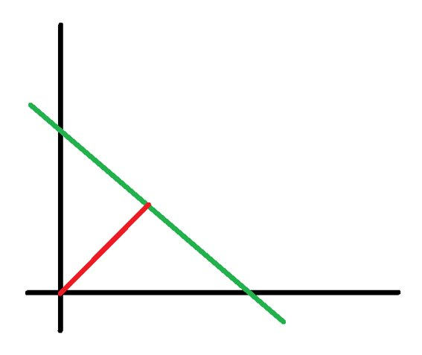
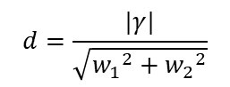
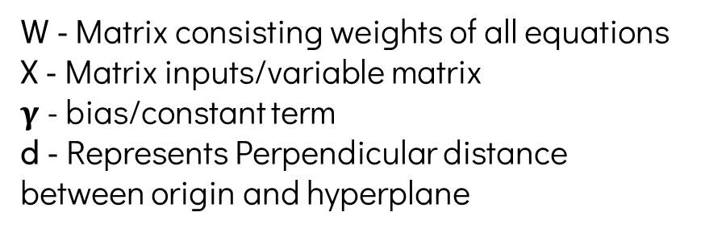
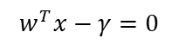
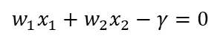
Deriving objective function
$$w_{1}x_{1}+w_{2}x_{2}−γ=0$$
$$w^{T}x−γ=0$$
$$d=\frac{|γ|}{\sqrt{{w_{1}}^{2}+{w_{2}}^{2}}}$$
W - Matrix consisting weights of all equations​​
X - Matrix inputs/variable matrix​​
$γ$- bias/constant term​​
d - Represents Perpendicular distance between origin and hyperplane​

Slide 9
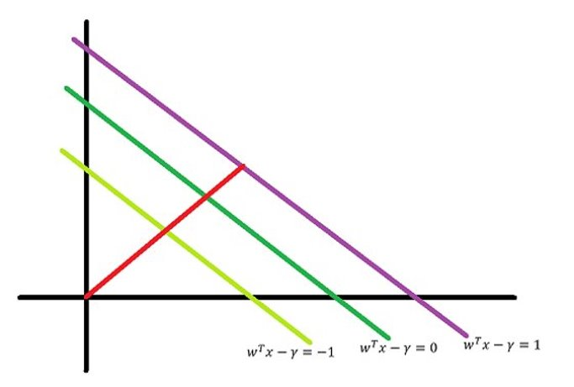
This diagram depicts Hyper planes with their respective equations as follows,
$$w_{1}x_{1}+w_{2}x_{2}−γ=1 or w^{T}x−γ=1$$
$$w_{1}x_{1}+w_{2}x_{2}−γ=0 or w^{T}x−γ=0$$
$$w_{1}x_{1}+w_{2}x_{2}−γ=−1 or w^{T}x−γ=−1$$

Slide 10
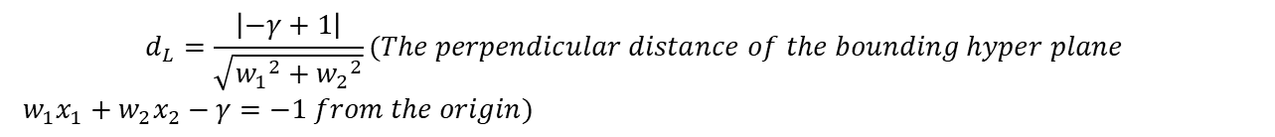
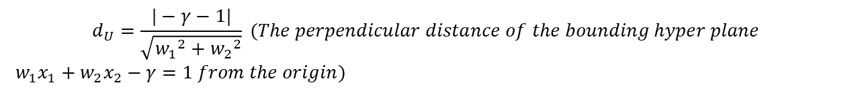
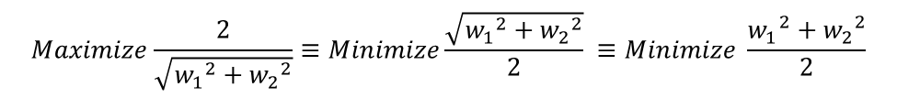
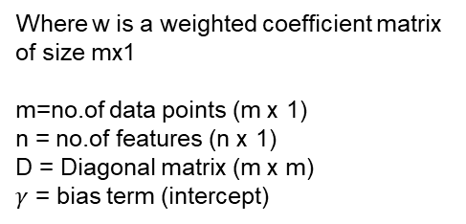
$$d_{U}=\frac{|−γ−1|}{\sqrt{{w_{1}}^{2}+{w_{2}}^{2}}} (The perpendicular distance of the bounding hyper plane$$
$w_{1}x_{1}+w_{2}x_{2}−γ=1 from the origin)$
$$d_{L}=\frac{\left|−γ+1\right|}{\sqrt{{w_{1}}^{2}+{w_{2}}^{2}}}(The perpendicular distance of the bounding hyper plane$$
$w_{1}x_{1}+w_{2}x_{2}−γ=−1 from the origin)$
$$Margin=d_{U}−d_{L}=\frac{\left|−γ−1+γ−1\right|}{\sqrt{{w_{1}}^{2}+{w_{2}}^{2}}}=\frac{2}{\sqrt{{w_{1}}^{2}+{w_{2}}^{2}}} (distance between the bounding hyper planes)$$
$$Our final point is to find w and γ that maximises this distance,$$
$$Maximize\frac{2}{\sqrt{{w_{1}}^{2}+{w_{2}}^{2}}}≡Minimize\frac{\sqrt{{w_{1}}^{2}+{w_{2}}^{2}}}{2} ≡Minimize \frac{{w_{1}}^{2}+{w_{2}}^{2}}{2}$$
Where w is a weighted coefficient matrix of size mx1
m=no.of data points (m x 1)
n = no.of features (n x 1)
D = Diagonal matrix (m x m)
$γ$ = bias term (intercept)
$$Minimize \frac{1}{2}w^{T}w ≡Minimize \frac{1}{2}{||w||}^{2}$$
$$Subject toD\left[Aw −γe\right]≥e$$

Slide 11
Soft margin SVM

Slide 12
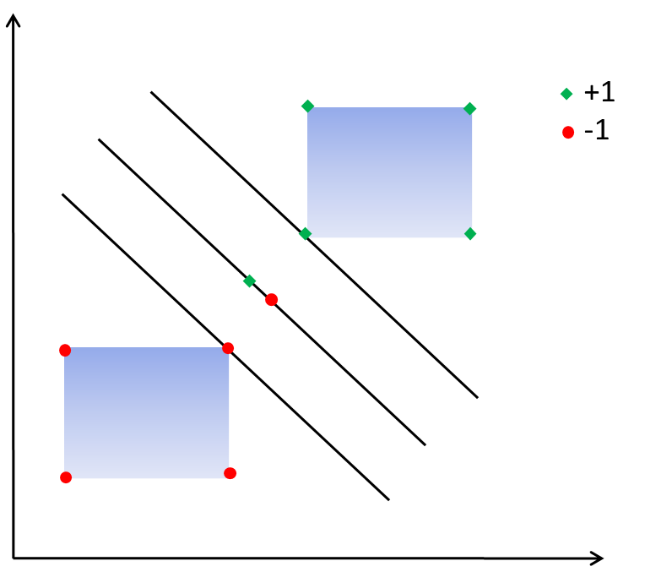
Linearly inseparable data: - no feasible solution - optimization problem corresponding to Hard Margin Support Vector Machine unsolvable.
So the only possible way is to find a maximally separating plane with a small number of points that fall on the wrong side.
More margin will cause more points with error. So we introduce a control parameter C through which we control the weight given to these two contradicting requirements.

Slide 13
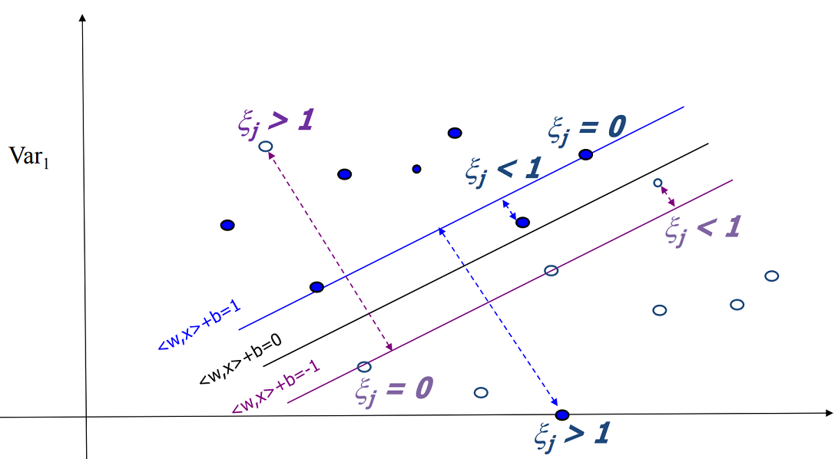

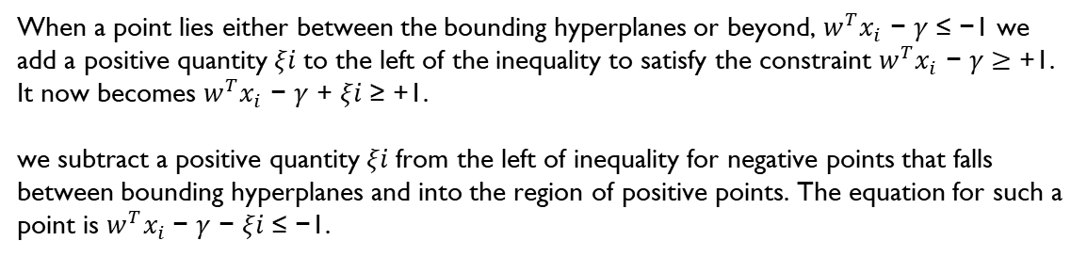
Key Idea: allow for some slight error represented by slack variables $ξ_{i}$($ξ_{i}≥0$).
When a point lies either between the bounding hyperplanes or beyond, $w^{T}x_{i}$ − 𝛾 ≤ −1 we add a positive quantity 𝜉𝑖 to the left of the inequality to satisfy the constraint $w^{T}x_{i}$ − 𝛾 $≥$ +1. It now becomes $w^{T}x_{i}$ − 𝛾 + 𝜉𝑖 ≥ +1.
we subtract a positive quantity 𝜉𝑖 from the left of inequality for negative points that falls between bounding hyperplanes and into the region of positive points. The equation for such a point is $w^{T}x_{i}$− 𝛾 − 𝜉𝑖 ≤ −1.

Slide 14
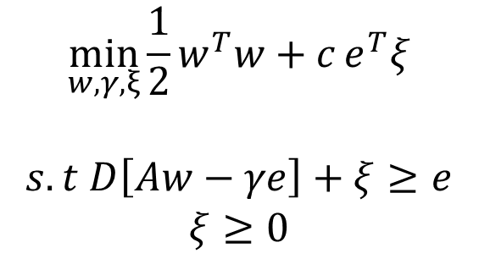
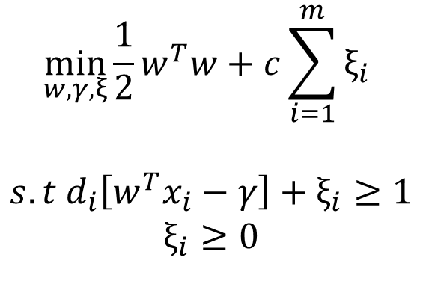
L1- SVM with soft margin
SVM formulation
In Matrix form
$$\min_{w,γ,ξ}{\frac{1}{2}w^{T}w+c\sum_{i=1}^{m}{ξ_{i}}}$$
$$s.t d_{i}\left[w^{T}x_{i}−γ\right]+ξ_{i}≥1$$
$$ξ_{i}≥0$$
$$\min_{w,γ,ξ}{\frac{1}{2}w^{T}w+c}e^{T}ξ$$
$$s.t D\left[Aw−γe\right]+ξ≥e$$
$$ξ≥0$$

Slide 15
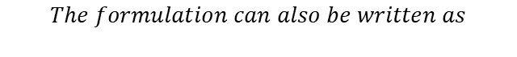
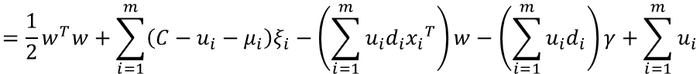
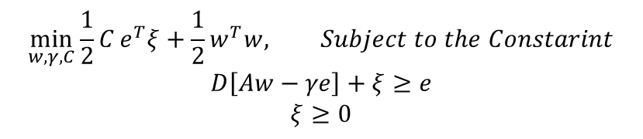
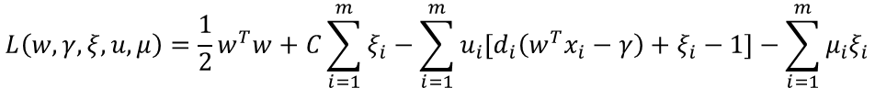
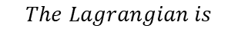
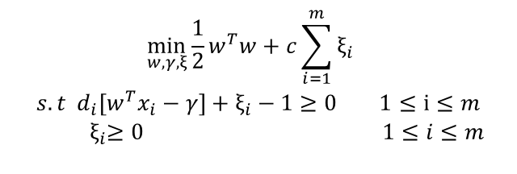
Dual formulation of L1 SVM
$$\min_{w,γ,C}{\frac{1}{2}C}e^{T}ξ+\frac{1}{2}w^{T}w, Subject to the Constarint$$
$$D\left[Aw−γe\right]+ξ≥e$$
$$ξ≥0$$
$$The formulation can also be written as$$
$$\begin{aligned}\min_{w,γ,ξ}{\frac{1}{2}w^{T}w+c\sum_{i=1}^{m}{ξ_{i}}} \\ s.t d_{i}\left[w^{T}x_{i}−γ\right]+ξ_{i}−1≥0 1≤\text{i}≤m \\ { ξ}_{i}≥0 1≤i≤m \\ \end{aligned}$$
$$The Lagrangian is$$
$$L\left(w,γ,ξ,u,μ\right)=\frac{1}{2}w^{T}w+C\sum_{i=1}^{m}{ξ_{i}−\sum_{i=1}^{m}{u_{i}\left[d_{i}\left(w^{T}x_{i}−γ\right)+ξ_{i}−1\right]−\sum_{i=1}^{m}{μ_{i}ξ_{i}}}}$$
$$=\frac{1}{2}w^{T}w+\sum_{i=1}^{m}{\left(C−u_{i}−μ_{i}\right)ξ_{i}−\left(\sum_{i=1}^{m}{u_{i}d_{i}{x_{i}}^{T}}\right)w−\left(\sum_{i=1}^{m}{u_{i}d_{i}}\right)γ+\sum_{i=1}^{m}{u_{i}}}$$
$$Where u,μ are the Lagrange multipliers$$

Slide 16
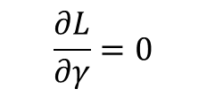
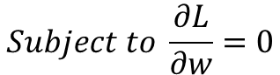
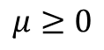
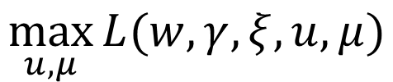
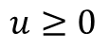
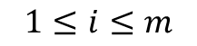
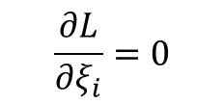
The wolfe of the problem is
$$\max_{u,μ}{L(w,γ,ξ,u,μ)}$$
$$Subject to \frac{∂L}{∂w}=0$$
$$\frac{∂L}{∂ξ_{i}}=0$$
$$1≤i≤m$$
$$\frac{∂L}{∂γ}=0$$
$$μ≥0$$
$$u≥0$$

Slide 17
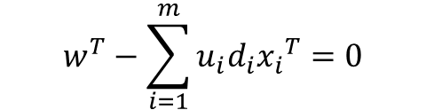
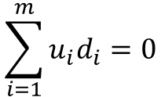
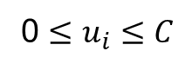
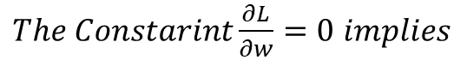
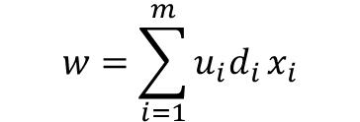
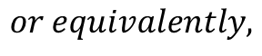
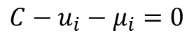
$The Constarint\frac{∂L}{∂w}=0$ $implies$
$$w^{T}−\sum_{i=1}^{m}{u_{i}d_{i}{x_{i}}^{T}=0}$$
$$or equivalently,$$
$$w=\sum_{i=1}^{m}{u_{i}d_{i}}x_{i}$$
$The Constarint\frac{∂L}{∂γ}=0$ $implies$
$$\sum_{i=1}^{m}{u_{i}d_{i}}=0$$
$The Constarint\frac{∂L}{∂ξ_{i}}=0$ $implies$
$$C−u_{i}−μ_{i}=0$$
$$1≤i≤m$$
$$Note that u>0,m>0, and we have$$
0 $≤u_{i}≤C$

Slide 18
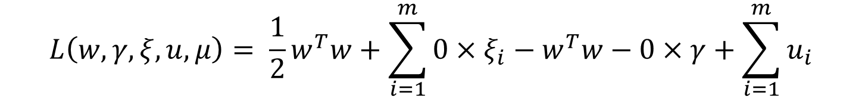
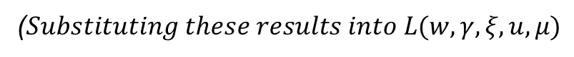
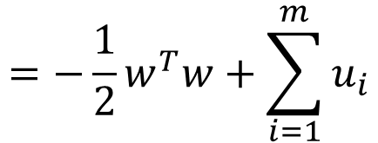
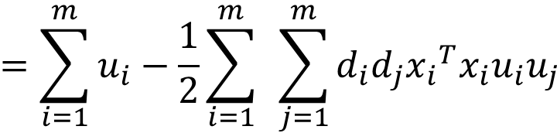
($Substituting these results into L(w,γ,ξ,u,μ)$
$$L\left(w,γ,ξ,u,μ\right)= \frac{1}{2}w^{T}w+\sum_{i=1}^{m}{0×ξ_{i}−w^{T}w−0}×γ+\sum_{i=1}^{m}{u_{i}}$$
$$=−\frac{1}{2}w^{T}w+\sum_{i=1}^{m}{u_{i}}$$
$$=\sum_{i=1}^{m}{u_{i}−\frac{1}{2}\sum_{i=1}^{m}{ }\sum_{j=1}^{m}{d_{i}d_{j}{x_{i}}^{T}x_{i}u_{i}u_{j}}}$$

Slide 19
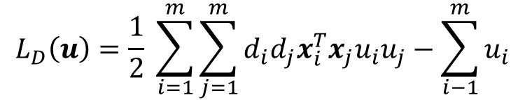
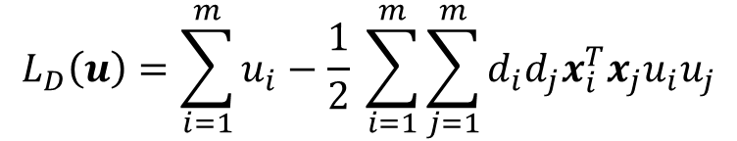
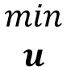
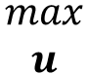
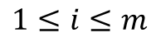
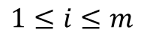
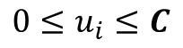



The dual problem is
$$L_{D}\left(u\right)=\sum_{i=1}^{m}{u_{i}−\frac{1}{2} \sum_{i=1}^{m}{\sum_{j=1}^{m}{d_{i}d_{j}x_{i}^{T}x_{j}u_{i}u_{j}}}}$$
$$\begin{matrix}max \\ u\end{matrix}$$
$$\sum_{i=1}^{m}{d_{i}u_{i}}=0$$
Subject to
$$0≤u_{i}≤C$$
$$1≤i≤m$$
or
$$L_{D}\left(u\right)=\frac{1}{2} \sum_{i=1}^{m}{\sum_{j=1}^{m}{d_{i}d_{j}x_{i}^{T}x_{j}u_{i}u_{j}}}−\sum_{i−1}^{m}{u_{i}}$$
$$\begin{matrix}min \\ u\end{matrix}$$
$$\sum_{i=1}^{m}{d_{i}u_{i}}=0$$
Subject to
$$0≤u_{i}≤C$$
$$1≤i≤m$$

Slide 20




In matrix form it can be written as follows:
$$L_{D}\left(u\right)=\frac{1}{2}u^{T}Qu−e^{T}u$$
Minimise
$$d^{T}u=0, 0≤u≤C_{e}$$
$$Here Q=DAA^{T}D and A is data matrix. Each data is a row vector in matrix A$$
$$Note that in matrix, Q can be computed as$$
$$Q=\left(A∗A^{T}\right).∗(d∗d^{T})$$
$$Weight, W=A^{′}∗(u.∗d)$$

Slide 21


$The main difference between L1−norm soft margin and hard margin SVM Classifier is that$
$$in case of the soft margin, the Lagrangian multiplier u_{i}s are bounded.$$
$That is,$
$$0≤u_{i}≤C;i=1,2, …, m$$
$$KKT \left(complementary\right)conditions have the following three cases for u_{i}$$
$u_{i}=0. Then ξ_{i}=1 \left(corresponding data points do not require positive{ ξ}_{i}\right).$
$Thus x_{i}\left(ith data point in the training set\right) is correctly classified.$

Slide 22


$0<u_{i}<C. Then d_{i}\left(w^{T}x_{i}−γ\right)+ξ_{i}=1 and{ ξ}_{i}=0.$
$Then{ x}_{i} is a support vector. Such support vectors with 0<u_{i}<C$
$are called unbounded support vectors.$ $These are the points falling on the bounding places of the class to$
$which the points belong.$
$u_{i}=C then d_{i}\left(w^{T}x_{i}−γ\right)+ξ_{i}=1 andξ_{i}>0. Then x_{i} is a support vector.$
$Such support vectors with u_{i}=C are called ′bounded support vectors^{′}.$ $These are the points falling outside the bounding plane of the$
$respective classes to which the points belong. If 0≤ξ_{i}<1, then x_{i} is correctly classified, and if ξ_{i}≥1, it is misclassified.$

Slide 23




L2 SVM LINEAR FORM (LS SVM)
$$In L2 norm SVM, the sum of squares of error \left(slack\right)variable are minimised along with$$
$reciprocal of the square of the margin between the bounding planes.$
$The formulation of the problem is given by$
$$\begin{matrix}min \\ w,γ,ξ\end{matrix}\frac{1}{2}w^{T}w+\frac{C}{2}\sum_{i=1}^{m}{ξ_{1}^{2}}$$
$$subject to d_{i}\left(w^{T}x_{i}−γ\right)+ξ_{i}−1≥0, 1≤i≤m$$
$${ ξ}_{i}≥0, 1≤i≤m$$
$$The Lagrangian is$$
$$L\left(w,γ,ξ,u\right)=\frac{1}{2}w^{T}w+\frac{C}{2}\sum_{i=1}^{m}{ξ_{1}^{2}}−\sum_{i=1}^{m}{u_{i}}\left[d_{i}\left(w^{T}x_{i}−γ\right)+ξ_{i}−1\right]$$
$$=\frac{1}{2}w^{T}w+\frac{C}{2}\sum_{i=1}^{m}{ξ_{1}^{2}}−\left(\sum_{i=1}^{m}{u_{i}}d_{i}x_{i}^{T}\right)w−\left(\sum_{i=1}^{m}{u_{i}}d_{i}\right)γ−\sum_{i=1}^{m}{u_{i}}ξ_{i}+\sum_{i=1}^{m}{u_{i}}$$
$$where u are the Lagrange multipliers.$$

Slide 24







$$Note that in Lagrangian, the Lagrangian multipliers corresponding to the constraint$$
$ξ_{i}≥0, 1≤i≤m haven′t been considered. This is because ξ_{i}becomes a function of u_{i} alone$
$and all u_{i} s are unbounded (on positive side) as derived in the following:$
$$The Wolfe dual of the problem is$$
$${max \atop u,μ}L(w,γ,ξ,u,μ)$$
$$\frac{∂L}{∂w}=0$$
$$subject to$$
$$\frac{∂L}{∂γ}=0$$
$$\frac{∂L}{∂ξ_{i}}=0 1≤i≤m$$
$$u≥0$$

Slide 25









$$The constraint \frac{∂L}{∂w}=0 implies:$$
$$w^{T}−\sum_{i=1}^{m}{u_{i}d_{i}x_{i}^{T}}=0$$
$$or equivalently,$$
$$w=\sum_{i=1}^{m}{u_{i}d_{i}x_{i}}$$
$$The constraint \frac{∂L}{∂γ}=0 implies:$$
$$The constraint \frac{∂L}{∂γ}=0 implies:$$
$$\sum_{i=1}^{m}{u_{i}d_{i}}=0$$
$$The constraint \frac{∂L}{∂ξ_{i}}=0 imply:$$
$$Cξ_{i}−u_{i}=0, 1≤i≤m.$$
$$Note that u≥0, and we have$$

Slide 26





$$Substituting these results into L\left(w,γ,ξ,u\right),$$
$$L\left(w,γ,ξ,u\right)=\frac{1}{2}w^{T}w+\frac{1}{2C}\sum_{i=1}^{m}{u_{i}^{2}}−w^{T}w−0∗γ−\frac{1}{C}\sum_{i=1}^{m}{u_{i}^{2}}+\sum_{i=1}^{m}{u_{i}}$$
$$=−\frac{1}{2}w^{T}w+\sum_{i=1}^{m}{u_{i}}−\frac{1}{2C}\sum_{i=1}^{m}{u_{i}^{2}}$$
$$=\sum_{i=1}^{m}{u_{i}}−\frac{1}{2}\sum_{i=1}^{m}{\sum_{i=1}^{m}{d_{i}d_{j}x_{i}^{T}x_{j}u_{i}u_{j}}}−\frac{1}{2C}\sum_{i=1}^{m}{u_{i}^{2}}$$
$$multiplying numerator and denominator with u_{i}u_{j}d_{i}d_{j}$$
$$=\sum_{i=1}^{m}{u_{i}}−\frac{1}{2}\sum_{i=1}^{m}{\sum_{i=1}^{m}{d_{i}d_{j}u_{i}u_{j}}}(x_{i}^{T}x_{j}+\frac{δ_{ij}}{C})$$
$$where δ_{ij}=\frac{ui^{2}}{u_{i}u_{j}d_{i}d_{j} }$$

Slide 27





$$To summarise, the dual problem is$$
$$\begin{matrix}max \\ u\end{matrix}L(u)=\sum_{i=1}^{m}{u_{i}}−\frac{1}{2}\sum_{i=1}^{m}{\sum_{i=1}^{m}{d_{i}d_{j}u_{i}u_{j}}}(x_{i}^{T}x_{j}+\frac{δ_{ij}}{C})$$
$$\sum_{i=1}^{m}{{d_{i}u}_{i}=0}$$
$$subject to$$
$$u_{i}≥0 1≤i≤m$$

Slide 28









$$The standard form in matrix format is$$
$$\begin{matrix}min \\ u\end{matrix}L\left(u\right)=\frac{1}{2}u^{T}D\left(AA^{T}+\frac{I}{C}\right)Du−e^{T}u$$
$$subject to$$
$$d^{T}u=0$$
$$u≥0$$
$$or$$
$$\begin{matrix}min \\ u\end{matrix}L\left(u\right)=\frac{1}{2}u^{T}Qu−e^{T}u$$
$$subject to$$
$$d^{T}u=0$$
$$u≥0$$
$$In matlab notation, Q can be computed as Q=\left(A∗A^{T}+I/C\right).∗(d∗d^{T})$$

Slide 29



$$How to Compute γ !?$$
$$According to the KKT complementarity Theorem, at optimal point:$$
$$u_{i}\left(d_{i}\left(w^{T}x_{i}−γ\right)+ξ_{i}−1\right)=0$$
$$So either u_{i}=0 or \left(d_{i}\left(w^{T}x_{i}−γ\right)+ξ_{i}−1\right)=0$$
$$that is, if u_{i}>0, then \left(d_{i}\left(w^{T}x_{i}−γ\right)+ξ_{i}−1\right)=0$$
$$Substituting the optimal values of w andξ_{i}, we obtain$$
$$d_{i}\left(\sum_{j=1}^{m}{u_{j}d_{j}x_{j}^{T}x_{i}+\frac{d_{i}}{C}u_{i}−γ}\right)−1=0; [because d_{i}d_{i}=+1]$$

Slide 30



$$d_{i}\left(\sum_{j=1}^{m}{u_{j}d_{j}\left(x_{j}^{T}x_{i}+\frac{δ_{ij}}{C}\right)−γ}\right)−1=0$$
$$\sum_{j=1}^{m}{u_{j}d_{j}\left(x_{j}^{T}x_{i}+\frac{δ_{ij}}{C}\right)−γ}=\frac{1}{d_{i}}=d_{i}$$
$$γ=\sum_{j=1}^{m}{u_{j}d_{j}\left(x_{j}^{T}x_{i}+\frac{δ_{ij}}{C}\right)}−d_{i}$$

Slide 31

Non-linear SVM
The points are clustered such that the two classes are not linearly separable
Non-linear mapping of data into some higher dimensional space called feature space (F) where it is linearly separable
The hyperplane in feature space becomes a highly non-linear separating surface in the original input space.

Slide 32


Slide 33




$$m = number of data points in the training set$$
$$n = number of features (variables) in the data$$
$$x_{i}=\left[\begin{aligned}x_{i1} \\ x_{i2} \\ . \\ . \\ . \\ x_{in}\end{aligned}\right],n dimensional vector which represent a data point in "input space".$$
$$A=\left[\begin{aligned}x_{1}^{T} \\ x_{2}^{T} \\ . \\ . \\ . \\ x_{m}^{T}\end{aligned}\right]$$
$$AA^{T}=\left[\begin{matrix}\begin{matrix}x_{1}^{T}x_{1} & x_{1}^{T}x_{2} \\ . & .\end{matrix} & \begin{matrix}. & x_{1}^{T}x_{m} \\ x_{i}^{T}x_{j} & .\end{matrix} \\ \begin{matrix}. & . \\ x_{m}^{T}x_{1} & x_{m}^{T}x_{2}\end{matrix} & \begin{matrix}. & . \\ . & x_{m}^{T}x_{m}\end{matrix}\end{matrix}\right]$$
$$Note that \left(i, j\right)th element of AA^{T} is{ x}_{i}^{T}x_{j}. The matrix is called linear Kernel Matrix.$$
$$This basically imply that whatever information is needed for training$$
$is captured as dot products of the training vectors.$

Slide 34
KERNEL TRICK
$The kernel trick is used for obtaining dot products without explicitly$
$mapping the data points into higher dimensional space.$
$Then the SVM based non−linear classifiers have the following advantages:$
$$1. The training algorithm is the same as that of the linear classifier.$$
$$2. The problem of{}_{ }^{′}curse of dimentionality^{′} is tackled in a simple way.$$
$$\text{The} \text{kernel} \text{trick} \text{uses} \text{Mercer}\text{’}\text{s} \text{condition}\text{, }\text{which} \text{states} \text{that} \text{any} \text{positive} \text{semi}\text{−}\text{definite} \text{kernel}$$
$$\text{K}\text{(}\text{x}\text{, }\text{y}\text{) }\text{can} \text{be} \text{expressed} \text{as} \text{a} \text{dot} \text{product} \text{in} \text{a} \text{high}\text{−}\text{dimensional} \text{space}\text{.}$$

Slide 35


$$∅\left(.\right)→x A non−linear mapping function that maps input vector x into a$$
$high dimentional feature vector$
$$K=\left[\begin{matrix}\begin{matrix}∅{\left(x_{1}\right)}^{T}∅(x_{1}) & ∅{\left(x_{1}\right)}^{T}∅(x_{2}) \\ ∅{\left(x_{2}\right)}^{T}∅(x_{1}) & ∅{\left(x_{2}\right)}^{T}∅(x_{2})\end{matrix} & \begin{matrix}. & \begin{matrix}. & ∅{\left(x_{1}\right)}^{T}∅(x_{m})\end{matrix} \\ . & \begin{matrix}. & ∅{\left(x_{2}\right)}^{T}∅(x_{m})\end{matrix}\end{matrix} \\ \begin{matrix}. & . \\ \begin{matrix}. \\ ∅{\left(x_{m}\right)}^{T}∅(x_{1})\end{matrix} & \begin{matrix}. \\ ∅{\left(x_{m}\right)}^{T}∅(x_{2})\end{matrix}\end{matrix} & \begin{matrix}. & \begin{matrix}. & .\end{matrix} \\ \begin{matrix}. \\ .\end{matrix} & \begin{matrix}\begin{matrix}. \\ .\end{matrix} & \begin{matrix}. \\ ∅{\left(x_{m}\right)}^{T}∅(x_{m})\end{matrix}\end{matrix}\end{matrix}\end{matrix}\right]$$
$$K is called the non−linear Kernel of input dataset$$
$function ∅\left(.\right) may be used to map each data point x, in to a higher dimensional space, and then$
$to try for a maximally separating hyperplane in that space as a classifier.$ $If such a separation$
$is possible, the SVM algorithm for training requires \left(x\right)\left(x,\right)for all i and j. If such explicit$
$mapping is being done and the dot product is mapped in the higher dimensional space,$
$then the computational requirement is huge especially when either dimension of the data is high$
$or the number of data points is high or both are high.$

Slide 36



Explanation of kernel trick
$$Consider solving the simplest one−dimensional classification problem given the input and$$
$$the output \left(desired\right)values as follows:A=\left[\begin{matrix}−1 \\ 0 \\ 1\end{matrix}\right] and d=\left[\begin{matrix}−1 \\ 1 \\ −1\end{matrix}\right]$$
$$Let ∅\left(X\right)=\left[\begin{matrix}∅_{1}(x) \\ ∅_{2}(x) \\ ∅_{3}(x)\end{matrix}\right]=\left[\begin{matrix}x^{2} \\ \sqrt{2}x \\ 1\end{matrix}\right]$$
$$The mapping produces the following three points in the feature space (shown as the rows$$
$of the matrix F (F standing for features)):$
$$F=\left[\begin{matrix}∅_{1}{\left(x\right)}^{T} \\ ∅_{2}{\left(x\right)}^{T} \\ ∅_{3}{\left(x\right)}^{T}\end{matrix}\right]=\left[\begin{matrix}1 & −\sqrt{2} & 1 \\ 0 & 0 & 1 \\ 1 & \sqrt{2} & 1\end{matrix}\right]$$

Slide 37



$$The Kernal K is given by$$
$$K=F∗F^{T}=\left[\begin{matrix}1 & −\sqrt{2} & 1 \\ 0 & 0 & 1 \\ 1 & \sqrt{2} & 1\end{matrix}\right]\left[\begin{matrix}1 & 0 & 1 \\ −\sqrt{2} & 0 & \sqrt{2} \\ 1 & 1 & 1\end{matrix}\right]$$
$$We now show that the mapping obtained by ∅\left(x\right)=\left[\begin{matrix}x^{2} \\ \sqrt{2}x \\ 1\end{matrix}\right] is a scalar product$$
$$implementation of a quadratic kernel function {\left(x^{T}x+1\right)}^{2}=k\left(x_{i}, x_{j}\right).$$

Slide 38




$$K=\left[\begin{matrix}∅{\left(x_{1}\right)}^{T}∅(x_{1}) & ∅{\left(x_{1}\right)}^{T}∅(x_{2}) & ∅{\left(x_{1}\right)}^{T}∅(x_{3}) \\ ∅{\left(x_{2}\right)}^{T}∅(x_{1}) & ∅{\left(x_{2}\right)}^{T}∅(x_{2}) & ∅{\left(x_{2}\right)}^{T}∅(x_{3}) \\ ∅{\left(x_{3}\right)}^{T}∅(x_{1}) & ∅{\left(x_{3}\right)}^{T}∅(x_{2}) & ∅{\left(x_{3}\right)}^{T}∅(x_{3})\end{matrix}\right]$$
$$=\left[\begin{matrix}{{(x}_{1}^{T}x_{1}+1)}^{2} & {{(x}_{1}^{T}x_{2}+1)}^{2} & {{(x}_{1}^{T}x_{3}+1)}^{2} \\ {{(x}_{2}^{T}x_{1}+1)}^{2} & {{(x}_{2}^{T}x_{2}+1)}^{2} & {{(x}_{2}^{T}x_{3}+1)}^{2} \\ {{(x}_{3}^{T}x_{1}+1)}^{2} & {{(x}_{3}^{T}x_{2}+1)}^{2} & {{(x}_{3}^{T}x_{3}+1)}^{2}\end{matrix}\right]$$
$$=\left[\begin{matrix}{(1+1)}^{2} & {(0+1)}^{2} & {(−1+1)}^{2} \\ {(0+1)}^{2} & {(0+1)}^{2} & {(0+1)}^{2} \\ {(−1+1)}^{2} & {(0+1)}^{2} & {(1+1)}^{2}\end{matrix}\right]$$
$$=\left[\begin{matrix}4 & 1 & 0 \\ 1 & 1 & 1 \\ 0 & 1 & 4\end{matrix}\right]$$

Slide 39






SVM Formulation of Non-Linear Kernels with Soft Margin (L1 Norm with Bias Term)
$$The formulation can be written as$$
$$\min_{w,γ,ξ}{\frac{1}{2}}w^{T}w+C\sum_{i=1}^{m}{ξ_{i}}$$
$$Subject to$$
$$d_{i}\left(w^{T}φ\left(x_{i}\right)−γ\right)+ξ_{i}−1≥0$$
$$1≤\text{i}≤m$$
$${ ξ}_{i}≥0$$
$$1≤\text{i}≤m$$
$$The Lagrangian is$$
$$L\left(w,γ,ξ,u,μ\right)= \frac{1}{2}w^{T}w+C\sum_{i=1}^{m}{ξ_{i}}−\sum_{i=1}^{m}{u_{i}\left[d_{i}\left(w^{T}φ\left(x_{i}\right)−γ\right)+ξ_{i}−1\right]−\sum_{i=1}^{m}{μ_{i}ξ_{i}}}$$
$$=\frac{1}{2}w^{T}w+\sum_{i=1}^{m}{\left(C−u_{i}−μ_{i}\right)ξ_{i}−\left(\sum_{i=1}^{m}{u_{i}d_{i}φ\left(x_{i}^{T}\right)}\right)w−\left(\sum_{i=1}^{m}{u_{i}d_{i}}\right)γ+\sum_{i=1}^{m}{u_{i}}}$$
$$Where u,μ are the Lagrange multipliers$$

Slide 40

















$$\max_{u,μ}{L(w,γ,ξ,u,μ)}$$
$$Subject to$$
$$\frac{∂L}{∂w}=0$$
$$\frac{∂L}{∂γ}=0$$
$$\frac{∂L}{∂ξ_{i}}=0$$
$$μ≥0$$
$$1≤\text{i}≤m$$
$$u≥0$$
$$The constarint\frac{∂L}{∂w}=0 implies$$
$$w^{T}−\sum_{i=1}^{m}{u_{i}d_{i}φ\left(x_{i}^{T}\right)=0}$$
$$Or equivalently,$$
$$w=\sum_{i=1}^{m}{u_{i}d_{i}φ\left(x_{i}^{ }\right)}$$
$$The constarint\frac{∂L}{∂γ}=0 implies$$
$$\sum_{i=1}^{m}{u_{i}d_{i}=0}$$
$$The constarint\frac{∂L}{∂ξ_{i}}=0 imples$$
$$C−u_{i}−μ_{i}=0$$
$$1≤\text{i}≤m$$
$$Note that u≥0,μ≥0, and we have$$
$$0≤u_{i}≤C$$

Slide 41






$$Substituting these results into L(w,.γ,ξ,u,μ)$$
$$L\left(w,.γ,ξ,u,μ\right)=\frac{1}{2}w^{T}w+\sum_{i=1}^{m}{0×ξ_{i}−w^{T}w−0×γ+\sum_{i=1}^{m}{u_{i}}}$$
$$=−\frac{1}{2}w^{T}w+\sum_{i=1}^{m}{u_{i}}$$
$$=\sum_{i=1}^{m}{u_{i}−\frac{1}{2}\sum_{i=1}^{m}{ }\sum_{j=1}^{m}{d_{i}d_{j}∅(x_{i}^{T}})∅(x_{j})u_{i}u_{j}}$$
$$The dual problem is$$
$$\max_{u}{L(u)}=\sum_{i=1}^{m}{u_{i}−\frac{1}{2}\sum_{i=1}^{m}{ }\sum_{j=1}^{m}{d_{i}d_{j}φ\left(x_{i}^{T}\right)φ\left(x_{j}\right)u_{i}u_{j}}}$$
$$\sum_{i=1}^{m}{d_{i}u_{i}=0}$$
$$Subject to$$
$$0≤u_{i}≤C$$
$$1≤\text{i}≤m$$

Slide 42



$$The above dual problem can be converted into a minimization problem$$
$by changing the sign of objective function.$
$$Then in Matrix form,formulation become$$
$$Minimise L_{D}\left(u\right)=\frac{1}{2}u^{T}Qu−e^{T}u$$
$$Q=K.∗(d∗d^{T})$$
$$d^{T}u=0,0≤u≤Ce$$
$$Here Q=DKD and K is Kernel matrix$$

Slide 43








SVM Formulation of Non-Linear Kernels with Soft Margin (L2 Norm with Bias Term).
$$For linear SVM, the dual formulation is$$
$$\min_{u}{L\left(u\right)=\frac{1}{2}u^{T}D\left(AA^{T}+\frac{1}{C}\right)Du−e^{T}u}$$
$$Subject to$$
$$d^{T}u=0$$
$$u≥0$$
$$So for a non−linear kernel, the dual formulation is$$
$$\min_{u}{L\left(u\right)=\frac{1}{2}u^{T}D\left(K+\frac{1}{C}\right)Du−e^{T}u}$$
$$Subject to$$
$$d^{T}u=0$$
$$u≥0$$
Or
$$\min_{u}{L\left(u\right)=\frac{1}{2}u^{T}Qu−e^{T}u}$$
$$Q=\left(K+\frac{I}{C}\right).∗(d∗d^{T})$$
$$d^{T}u=0$$
$$u≥0$$

Slide 44




SVM Formulation of Non-Linear Kernels with Soft Margin (L1 Norm without Bias Term).
$$If no bias term is assumed, then the decision function is given by$$
$$w^{T}φ\left(X_{i}\right) = 0$$
$$The bounding planes are then{ w}^{T}φ\left(X_{i}\right)=+1 for positive samples and$$
$w^{T}φ\left(X_{i}\right)=−1 for negative samples.$
$$The SVM formulation is therefore written as$$
$$\begin{matrix}min \\ w,γ,ξ\end{matrix}\frac{1}{2}w^{T}w+C\sum_{i=1}^{m}{ξ_{i}}$$
$$subject to$$
$$d_{i}(w^{T}φ\left(X_{i}\right))+ξ_{i}−1≥0, 1≤i≤m$$
$$ξ_{i}≥0, 1≤i≤m$$

Slide 45









$$The Lagrangian is$$
$$L\left(w , ξ , u , μ\right) = \frac{1}{2}w^{T}w+C\sum_{i=1}^{m}{ξ_{i}}−\sum_{i=1}^{m}{u_{i}}\left[d_{i}\left(w^{T}φ\left(X_{i}\right)\right)+ξ_{i}−1\right]−\sum_{i=1}^{m}{μ_{i}ξ_{i}}$$
$$=\frac{1}{2}w^{T}w+\sum_{i=1}^{m}{\left(C−u_{i}−μ_{i}\right)ξ_{i}}−\left(\sum_{i=1}^{m}{u_{i}d_{i}φ\left(X_{i}^{T}\right)}\right)w+\sum_{i=1}^{m}{u_{i}}$$
$$where u, μ are the Lagrange multipliers, the Wolfe dual problem is$$
$$\begin{matrix}max \\ u,μ\end{matrix}L(w,ξ,u,μ)$$
$$subject to$$
$$\frac{∂L}{∂w}=0$$
$$\frac{∂L}{∂ξ_{i}}=0 1≤i≤m$$
$$u≥0$$
$$μ≥0$$

Slide 46








$$The constraint \frac{∂L}{∂w}=0 implies$$
$$w^{T}−\sum_{i=1}^{m}{u_{i}d_{i}φ\left(X_{i}^{T}\right)=0}$$
$$or equivalently,$$
$$w=\sum_{i=1}^{m}{u_{i}d_{i}φ\left(X_{i}\right)}$$
$$The constraint \frac{∂L}{∂ξ_{i}}=0 imply$$
$$C−u_{i}−μ_{i}=0, 1≤i≤m$$
$$Note that u≥0, μ≥0, and we have: 0≤u_{i}≤C$$
$$Substituting these results into L\left(w,ξ,u,μ\right):$$
$$L\left(w,ξ,u,μ\right)=\frac{1}{2}w^{T}w+\sum_{i=1}^{m}{0×ξ_{i}}−w^{T}w+\sum_{j=1}^{m}{u_{i}}$$
$$=−\frac{1}{2}w^{T}w+\sum_{i=1}^{m}{u_{i}}=\sum_{i=1}^{m}{u_{i}}−\frac{1}{2}\sum_{i=1}^{m}{\sum_{j=1}^{m}{d_{i}d_{j}φ\left(X_{i}^{T}\right)φ\left(X_{j}\right)u_{i}u_{j}}}$$

Slide 47






$$The dual of the problem is:$$
$$\begin{matrix}max \\ u\end{matrix}L(u)=\sum_{i=1}^{m}{u_{i}}−\frac{1}{2}\sum_{i=1}^{m}{\sum_{j=1}^{m}{d_{i}d_{j}φ\left(X_{i}^{T}\right)φ\left(X_{j}\right)u_{i}u_{j}}}$$
$$subject to$$
$$0≤u_{i}≤C, 1≤i≤m$$
$$This is equivalent to the following matrix formulation.$$
$$Minimise L_{D}\left(u\right)=\frac{1}{2}u^{T}Qu−e^{T}u$$
$$0≤u≤Ce$$
$$Here Q=DKD and K is the kernel matrix.$$
$$Q can be computed as Q=K. ∗(d ∗d^{T} ).$$

Slide 48







SVM Formulation of Non-Linear Kernels with Soft Margin (L2 Norm without Bias Term).
$$For a non−linear kernel, the dual formulation is$$
$$\begin{matrix}min \\ u\end{matrix}L\left(u\right)=\frac{1}{2}u^{T}D\left(K+\frac{I}{C}\right)Du−e^{T}u$$
$$subject to$$
$$u≥0$$
$$or$$
$$\begin{matrix}min \\ u\end{matrix}L\left(u\right)=\frac{1}{2}u^{T}Qu−e^{T}u$$
$$subject to$$
$$u≥0$$
$$Q=\left(K+\frac{I}{C}\right).∗(d∗d^{T})$$

Slide 49
Inference
The first objective we find a maximum-margin classifier, in terms of hyper-plane(the vectors W and b) that separates the positive and negative instances. The data set is noisy (with some Overlap in positive and negative samples), and there will be some errors in classifying them with the hyper-plane.
And we minimized the errors in the classification along with maximizing the margin and the problem became a soft-margin SVM problem. And Latter slack variables per training point are introduced to include the classification errors (miss-classified data points in the training set) in the objective. Since it is easier to solve the optimization problem in the dual rather than the primal space. Hence the optimization is often solved in the dual space by converting the minimization to a maximization (keeping in mind the weak/strong duality theorem and the complementary slackness conditions), constructing the Lagrangian, and then using the KKT conditions for a saddle point.
Since our data set is not linearly separable, the kernel trick is used to conceptually map the Data points to some higher dimensions only by computing the kernel matrix. We Implemented the RBF kernel function to classify. Finally, the dual and primal variables are used in conjunction to predict the class of a new data point.

Slide 50


